Slide 1
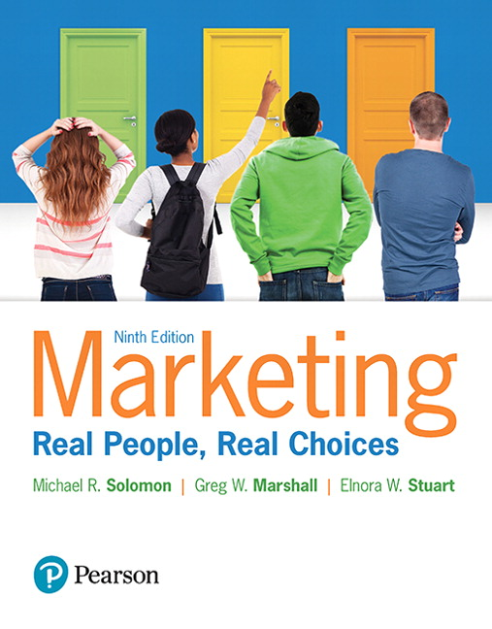
Marketing: Real People, Real Choices
Ninth Edition
Chapter 1
Welcome to the World of Marketing
Copyright © 2018, 2016, 2012 Pearson Education, Inc. All Rights Reserved.

Slide 2
Learning Objectives
1.1 Explain what marketing is, the marketing mix, what
can be marketed, and the value of marketing.
1.2 Explain the evolution of the marketing concept.
1.3 Understand value from the perspectives of
customers, producers, and society.
1.4 Explain the basics of market planning.

Slide 3
Real People, Real Choices: A Decision Maker at Twitter
Which option should be pursued?
Option 1: Hold weekly meetings to discuss ideas and innovations within Twitter
Option 2: Build an internal online tool to allow employees to share, build, and measure ideas
Option 3: Get feedback from the external Twitter community to shape Twitter’s product vision
Notes:
DISCUSSION NOTE:
This case is based on an actual person, Michael Baumwoll, who works at Twitter.
LECTURE NOTES:
Twitter is a social media platform that enables users to share their experiences at any time.
Twitter is always looking for ways to improve. They have numerous ways of sharing ideas within the company.
Michael is looking at several options for sharing ideas for improvement within Twitter.
Option 1: Hold weekly meetings to discuss ideas and innovations within Twitter.
Option 2: Build an internal online tool to allow employees to share, build, and measure ideas.
Option 3: Get feedback from the external community to shape Twitter’s product vision.
DISCUSSION NOTE:
Explain to students that you want them to think about each option, and that you will return to this question at the end of the chapter.

Slide 4
Marketing: What is it?
As consumers, you all know a lot about it!
Marketing is first and foremost about satisfying customer needs in a profitable manner.
Notes:
LECTURE NOTES:
You participate in the marketing process with every purchase you consider and transaction you make.
The consumer is at center of marketing activity, but it’s a two-way street.
Products are sold to satisfy both consumer’ and marketers’ needs.
But company also has objectives (to be profitable, survive, etc.) that need to be met in order for it to stay in business.

Slide 5
AMA Definition of Marketing
Marketing is the activity, set of institutions, and processes for creating, communicating delivering, and exchanging offerings that have value for customers, clients, partners, and society at large.
Notes:
LECTURE NOTES:
In a nutshell, this definition simply means that marketing seeks to deliver value to everyone who is affected by a transaction. The following slides discuss some of the key concepts incorporated within the definition of marketing in more detail.

Slide 6
Marketing Defined: Activity, Institutions, Processes
Marketing includes many different activities:
More than just sales and advertising
Involves interactions with non-marketers: Finance, HR, MIS, Operations, Accounting, etc.
Marketing is also a decision process.
Notes:
LECTURE NOTES:
Marketing encompasses a wide range of activities, beyond simple functions such as sales and advertising. They are: supply chain management and retailing, branding and new product development, market research, segmentation/targeting/positioning, other promotional mix elements.
Marketing activities affect, and are in turn affected, by, the firm’s other operations. Marketing managers work closely with personnel from other functional areas of the business. For instance:
Marketers work with accounting and finance in managing products, determining profitable prices, and setting marketing budgets.
Marketers work with operations to make sure products are produced in right quantities and on time.
Marketers work with R&D specialists and engineers to create and commercialize new product concepts.
Marketing is a process by which managers determine and implement the strategies that will help the firm achieve its long-term objectives.

Slide 7
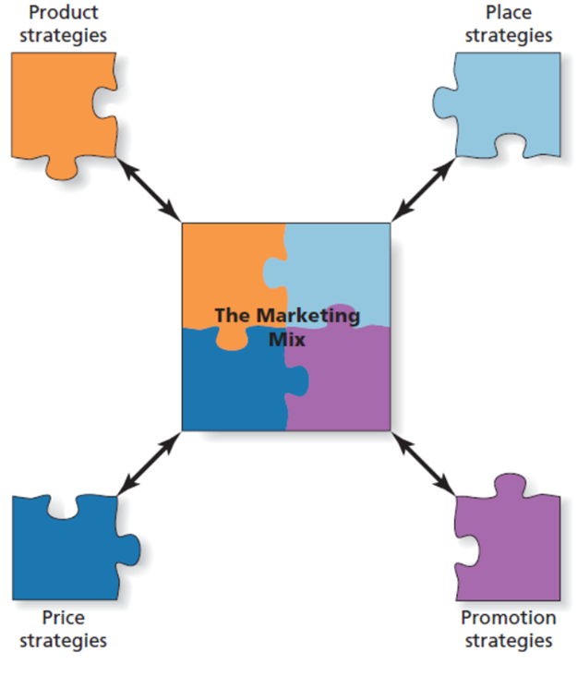
Marketing Defined: Creating, Communicating, Delivering, and Exchanging
Notes:
LECTURE NOTES:
The marketing mix consists of the tools used by the organization to create a desired response among its target market, and is commonly referred to as the 4 Ps.
Each of the four Ps represents a piece of the puzzle which must be solved to successfully market the product. The product, price, place, and promotion decisions are entirely interdependent, as symbolized by the fact that the puzzle pieces lock together.
Product—product aspects include all aspects of the product design, its packaging, and any associated aspects (such as warranty and free delivery). Determining the specific combination of benefits sought by consumers is a key marketing task.
Promotion—includes all activities marketers undertake to inform consumers about their product. Many marketers now refer to promotion as marketing communications, and includes advertising, personal selling, publicity and sales promotion activities directed at both consumers and the traders (retailers and wholesalers) who aid in the distribution of the product.
Price – the amount the consumer must exchange in order to receive the product or service offering. Higher prices can communicate higher quality for some goods. Marketers often lower price via sales promotions in order to increase demand.
Place – this “P” is key to making the product available to consumers at the desired time and location. Place decisions are closely tied to the supply chain – the set of firms that work together to get a product from a producer to a consumer.

Slide 8
Marketing Facilitates Exchange
Exchange occurs when one party gives up something and in return for receiving something else.
Conditions for Exchange
At least two people or organizations must be willing to make a trade.
Have something the other party wants
Agree on value of exchange and terms
Each party free to accept or reject exchange
Notes:
LECTURE NOTES:
An EXCHANGE RELATIONSHIP is at the heart of every marketing act. Marketing activities are implemented to facilitate mutually beneficial exchanges between parties.
In order for an exchange to take place, certain conditions must be met. If all conditions are not met, no exchange.
DISCUSSION NOTE:
It may be helpful to discuss the exchange process in detail for one or more products/services.
Examples:
New car purchase: Consumers exchange money, and possibly an older vehicle (trade-in) Dealership returns a physical auto, with warranty, and perhaps other add-ons (such as an introductory On*Star or XM radio subscription)
Vacation resort: Consumers exchange money and their precious/limited vacation time
Resort exchanges lodging, and potentially other services (depending upon whether it is an all inclusive), such as food, beverages, access to recreational facilities (pool, tennis courts, beach, wind surfers, etc.)
Politicians: Consumers exchange their vote (voters), time and effort (campaign staff), and potentially money (political campaign contributors). Politicians exchange promises in terms of how they intend to govern in the future if elected

Slide 9
Marketing Defined: Offerings
Product: any good, service, or idea
Consumer goods/services
Business-to-business goods/services
Not-for-profit marketing
Idea, place, and people marketing
Notes:
LECTURE NOTES:
Any good, service or idea that can be marketers is a product. Examples include the following:
Consumer goods/services: Services are intangible products that we pay for and use but never own. Items that are purchased for personal or family use. Diet Dr. Pepper, hotels for leisure travelers, clothing, washing machines, copy services. Services are intangible products that we pay for and use but never own. The ad on this slide is an example of services marketing (fencing company).
Business-to-business (B2B) goods: Involves industrial goods such as raw materials, which are converted into goods for sale or component parts that are integrated into manufactured goods. May also include finished goods that are distributed for resale, or finished goods/supplies, that are used in operating a business. While the most visible aspect of e-commerce to you are those firms which sell o over the Internet to consumers, the truth is that the majority of e-commerce occurs in the B2B arena.
Not-for-profit marketing: Museums, zoos, churches and organizations such as the YMCA are considered not-for-profit entities, due to the fact that the fees charged are used to offset costs rather than to make a profit.
Idea, Place, and People Marketing: Anti-smoking and anti-drinking and driving campaigns promote ideas; ads for Walt Disney World or the Bahamas market places, and ads for people may promote political candidates, celebrities or micro-celebrities (someone who is known by hundreds or thousands of Facebook friends, Twitter followers, or YouTube subscribers).
LinkedIn is another example of a marketing venue that people can use to market themselves.
The same concepts and techniques that apply in marketing celebrities may apply to how you can market yourself via your own blog or YouTube video. In fact, you need to be very careful what information appears on your Facebook or Twitter feed; many potential employers search these venues to learn more applicants, and less than professional photos or musing can cost you an interview or even a job.

Slide 10
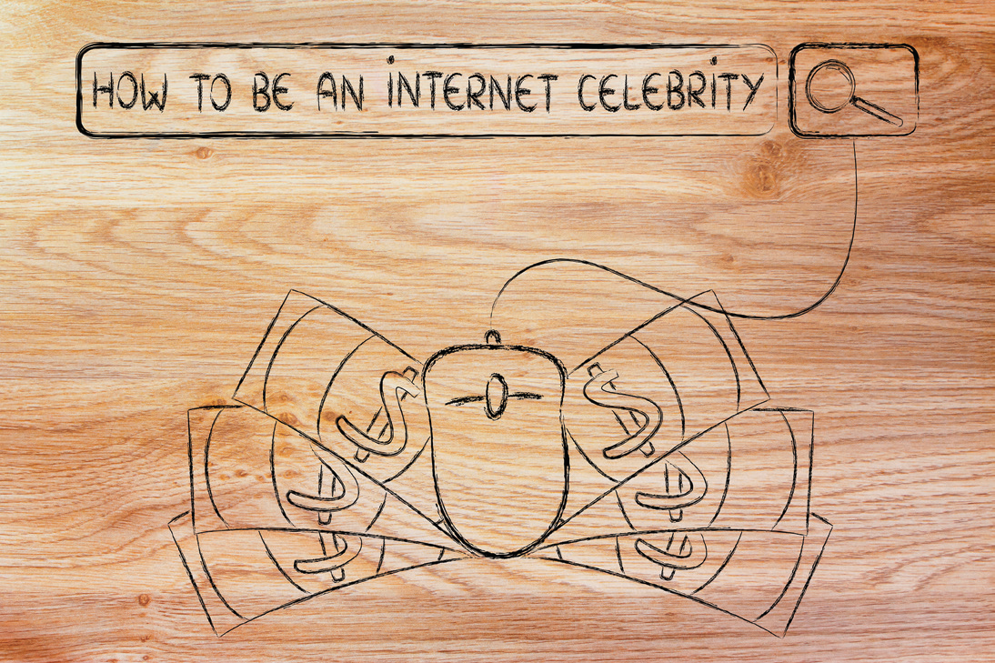
15 Minutes of Frame
People “package” themselves with their social media profiles.
Microcelebrity
Notes:
LECTURE NOTES:
Everyday individuals like yourself “package” your persona with your online social media profiles. Occasionally, someone posts something that goes “viral” and the entire world witnesses it for a short period of time—your “15 minutes of fame.” The concept of the microcelebrity has emerged. This is someone who is a celebrity for a very short period of time or someone who may not be known by millions of people, but may certainly have thousands of followers.

Slide 11
Marketing Defined: Value for Customers
Marketing concept
Modern marketers practice the marketing concept: identifying and satisfying the needs of consumers to ensure profitability.
Practicing the marketing concept is complex.
Notes:
LECTURE NOTES:
The MARKETING CONCEPT is defined on the slide above. Firm’s that embrace the marketing concept constantly seek information about current or changing needs from current and potential customers using company initiated research efforts such as focus groups and survey research.
STAKEHOLDERS are buyers, sellers, investors, community residents, citizens and consumers.
CONSUMERS are defined as the ultimate user of a good or service.
Products and services are sold to satisfy both consumers’ and marketers’ needs – thus consumers need items that provide value while marketers need to earn profits. While the “customer is king” mentality is a good way to train your employees to think, it must be implemented successfully and in a manner that allows the business can earn a profit.
Many firms also employ individuals who review BLOGS, newsgroup postings, and Internet-based complaint websites, in addition to analyzing feedback from consumers received via email, mail, or phone.

Slide 12
Needs, Wants, and Benefits
Needs
Difference between actual and desired state
Can be physiological or psychological
Wants
Desire to satisfy a need in a particular way
Influenced by history, past experience, and culture
Benefits
Consumer received benefit when need satisfied
Demand
Customers’ desires for products coupled with the resources needed to obtain them
Notes:
LECTURE NOTES:
NEEDS are defined here as the difference between a consumers’ actual state and some sort of ideal or desired state. So right now, some of you may be hungry, which is not ideal. After class, you may buy a snack or meal—actions designed to move you to your desired state.
Is a need the same as a want? Not really. There are many ways you can satisfy your hunger, but you want a Snickers candy bar. WANTS relate to specific brands or types of products, and are often socially or culturally influenced. Wants aren’t always affordable or realistic. For example, America is a highly mobile society; many people need a car. However, at least some of the people driving a practical, four-door sedan like the Toyota Camry WANTED to buy a two-door, fun to drive sports car, like a Porsche 911. Wants are typically influenced by both social (family, peers, etc.) and cultural factors.
Marketers try to motivate actions – purchases for example – that satisfy needs by providing consumers with products that offer the BENEFITS (need satisfying characteristics) they seek.
This is why the concept of DEMAND is so important. Demand includes only those consumers who have both the buying power and desire (want) for a particular brand

Slide 13
Markets and Marketplaces
A market consists of all consumers who share a common need that can be satisfied by a specific product, and who have resources, willingness and authority to purchase.
A marketplace is any location or medium used to facilitate an exchange.
Notes:
LECTURE NOTES:
A MARKET consists of all the consumers who share a common need that can be satisfied by a specific product, and who have the resources, willingness and authority to make the purchase.
A MARKETPLACE is where buyers and seller “meet” to exchange value. This used to mean a location where buying and selling occurred face-to-face. In developing countries, the marketplace may be an open-air market or a street corner where people sell fruits and vegetables much as they did thousands of years ago.
Information technology has altered how many people now choose to shop. Thus, while the modern marketplace may include F2F locations such as malls, farmer’s markets, or retail stores, it also now includes auction sites such as eBay, mail-order, TV shopping networks, or any of a host of B2C e-commerce websites.
Virtual marketplaces for cyberworlds like Second Life and Habbo Hotel generated more than $2.9 billion dollars in sales of virtual real estate, home furnishing and bling for players’ avatars.

Slide 14
Collaborative Consumption
Consumers increasingly would rather rent than purchase the products they use.
Examples?
Traditional marketers are also looking to take advantage of this trend.
Notes:
LECTURE NOTES:
Changes in technology and customer preferences have led to the emergence of new types of markets.
Zipcar rents autos by the hour, typically in large cities and in some college towns. This service creates benefit for consumers, as they can readily find and pay for a car where/when they need one, as opposed to purchasing a vehicle and only using for a small period of time during the week and having to worry about the hassle and expense of car loans, insurance, and parking.
This has impacted new car sales, so much so that traditional auto manufacturers like VW and BMW are exploring their own vehicle-sharing services.

Slide 15
Marketing Creates Utility
Utility represents the sum of benefits a consumer receives from use of a product.
Form utility
Place utility
Time utility
Possession utility
Notes:
LECTURE NOTES:
UTILITY is defined on the slide as the sum of the benefits we receive from using a product or service.
Marketing can create several different kinds of utility of interest to consumers:
FORM UTILITY: benefit provided by marketing when raw materials are transformed into finished goods; e.g., oats transformed into oatmeal; rubber into tires. (Relates to PRODUCT portion of marketing mix.)
PLACE UTILITY: benefit provided when marketing makes goods available where customers want them; e.g., many things can be purchased over the Internet. (Relates to DISTIBUTION/PLACE portion of marketing mix.)
TIME UTILITY: benefit provided by marketing when products are stored (or inventoried) until they are needed. Stores inventory products, as do wholesalers/distributors, and the manufacturers themselves. (Relates again to DISTRIBUTION/PLACE portion of marketing mix.)
POSSESSION UTILITY: benefit marketing provides by allowing the consumer to own, use, and enjoy the product. Promotional plans that offered deferred payment or even those which feature a sale may be exactly what the consumer needs to own a product. Retail stores and websites offer access to a bewildering array of products.

Slide 16
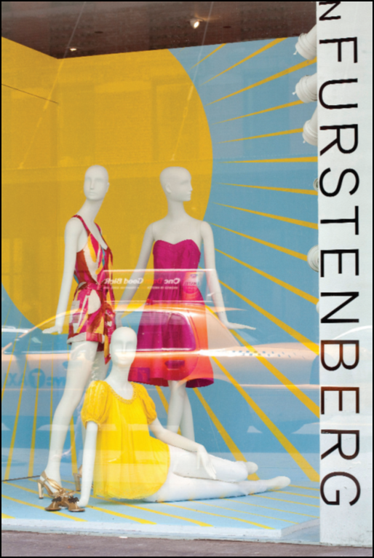
Place Utility
Rent the Runway is a new service that rents high-end dresses from fashion designers and rents them at a one-tenth of the cost of buying the same garment in the store.
Rent the Runway
Notes:
LECTURE NOTES:
Recall that Place utility is the benefit marketing provides by making products available where customers want them. Dresses are delivered directly to the renter’s address, and the customer returns the dress in a prepaid envelope, providing great place utility! To further entice consumers, women are able to rent the dress for four nights, and the rental cost includes the cost of dry cleaning enhancing the customer’s convenience.

Slide 17
Marketing Defined: Value for Society
Is it possible to make profits and contribute to society and the planet in a positive way?
Corporate responsibility at Target
In 2012, Target set goals for all seafood sold in stores to be sustainable and traceable.
Reusable bag program saves consumers $7 million.
50+% of apparel is labeled “machine wash cold” to help reduce energy consumption.
Notes:
LECTURE NOTES
Most large companies today pay attention to corporate social responsibility issues.
Firms like Target produce annual sustainability reports that highlight the firm’s goals and achievements in reducing its overall environmental impact. Wal-Mart is also a champion of corporate sustainability.
A growing segment of consumers take into account sustainability and other social issues in their decision-making and consumption behaviors.

Slide 18
Summary: Marketing Defined
Marketing encompasses activities and process that create, communicate, deliver value-based exchanges.
Benefits to stakeholders beyond just businesses and consumers
How does the definition of marketing relate to you as a consumer? To your future career?
Notes:
LECTURE NOTES:
Summarize elements of AMA definition of Marketing.
DISCUSSION NOTES:
Discussion emphasizes personal branding of students as they enter the workforce and manage their careers.

Slide 19
Evolution of the Marketing Concept
Production era
Selling era
Relationship era
Triple bottom-line era
Notes:
LECTURE NOTES:
Each of these eras varies with respect to the manner in which customer needs are researched and met, and the types of marketing efforts undertaken.

Slide 20
Production Era
Marketing dominated by a production orientation
A management philosophy that emphasizes the most efficient ways to produce and distribute products.
Marketing promotions played a minor role.
Henry Ford’s Model T and Ivory soap are examples of products that were created under a production orientation.
Notes:
LECTURE NOTES:
Production orientation: The production orientation was most popular during the beginning of the industrial revolution, when demand for products outstripped supply. Focus on manufacturing efficiency (e.g., production line) lowered the costs of goods so that greater masses of individuals could afford products like automobiles.
Firms that engaged in this orientation paid little attention to the desires of individual consumers, and instead marketed products that they wanted to make, the way they wanted make them. Many faculty and students may recall Henry Ford’s famous quote that customers “can have any color they want as long as it’s black.”
Because there are typically few alternatives available to consumers, consumers must buy whatever is available or go without.
However, because this orientation views consumer needs as homogeneous, as new competitors enter the market and develop variations that better satisfy customer needs, firms that maintain a production orientation lose business. Marketing efforts were minimal due to the nature of demand and supply.

Slide 21
Sales Era
Dominated by selling orientation
A managerial view of marketing as a sales function, or a way to move products out of warehouses to reduce inventory.
Emphasis on aggressive promotional activities
Post–World War II, production capacity exceeded demand.
Led businesses to focus on one-time sales of goods rather than repeat business.
Notes:
LECTURE NOTES:
Selling orientation: Some firms still embrace a selling orientation, which focuses on spending large sums of money to attract new customers. The selling orientation became popularized after World War II, when production shifted from weaponry back to consumer goods, and the supply of desired goods finally caught up with demand.
Sales promotions were heavily used to stimulate demand for goods, though advertising and personal selling were used as well to attempt to make a sale.
The selling orientation pays little attention to retaining customers, and poor customer service often leads to lost customers, which the firm must later replace. For example, loyal customers often become disgruntled at having to pay higher prices than those paid by new customers as part of an introductory or ongoing deal.
Marketing’s image was damaged during this time, as customers don’t like to be pushed or aggressively sold to.

Slide 22
Relationship Era
Focused upon a consumer orientation
A management philosophy that emphasizes satisfying customers’ needs and wants
Marketing plays a more central role
Emergence of the marketing concept
Total Quality Management (TQM) and other quality initiatives gains wide acceptance
Notes:
LECTURE NOTES:
The relationship era resulted in a large number of firms becoming more customer-oriented. While firms that adopted the marketing concept were doing well initially, inflation during the 1970s and the recession in the 1980s hurt company profits.
The total quality management philosophy was implemented by a number of firms through the 1990s as a way of not only meeting consumer needs, but doing so better than the competition on a regular basis. Total quality management is defined as a philosophy that involves all employees from the assembly line onward in continuous product quality improvement efforts.
Today many firms are manufacturing products on-demand (visit www.mymms.com to demonstrate how, for a substantial price, consumers can customize their own M&M messages) and technological advances such as the Internet have also given birth to the instapreneur (a business person who only produces a product once it is ordered).

Slide 23
Triple Bottom-Line Era
Management seeks to maximize financial, social, and environmental bottom lines.
Emergence of societal marketing concept
Emphasis on ROI measurement across all three areas
This ad focuses on the environmental bottom line
Notes:
LECTURE NOTES:
Firms embracing this mentality believe that their commitment to quality extends beyond satisfying customer needs during a single transaction.
The triple bottom line orientation focuses on:
The Financial Bottom Line —building long-term bonds with customers which emphasize financial profits to stakeholders.
The Social Bottom Line —contributing to the communities in which the firm operates (social bottom line), and
The Environmental Bottom Line —creating sustainable business practices that minimize damage to the environment or that even improve it (environmental bottom line).
As a result of the long-term thinking inherent in the triple bottom line era is the social marketing concept. The societal marketing concept is a marketing management philosophy that stipulates marketers must satisfy customers’ needs in ways that also benefit society and deliver value to the firm. Firms that practice the social marketing concept engage in satisfying environmental concerns, practicing recycling, add extra safety features, or practice sustainability.
For example, Wal-Mart, a corporate leader in sustainability practices, makes and sells photo frames from plastic waste products it creates and recycles materials left over from manufacturing private label diapers into building materials used in the construction of its stores. So, sustainability can not only be environmentally friendly but also cost-effective.
In order to substantiate and measure the impact of triple-bottom line initiatives, there has become a much greater focus on accountability of marketing activities. How do our actions impact each of the bottom lines?
This enhanced focus on accountability that typically centers around the calculation off ROI. The accountability aspect means that marketers must do a better job of proving that marketing activities align to the firm’s overall business objectives, especially since many marketing goals have traditionally been phrased in terms of communication aspects (increase awareness). While creating awareness and changing attitudes remain an important part task for marketers, marketing’s efforts must also demonstrate tangible benefits in terms of consumer actions—web site visits, product trial, and of course purchases, to name just a few.

Slide 24
Sustainability
Sustainability is about creating products that meet present needs while ensuring future generations can have their needs met.
Green marketing is one type of sustainable business practice.
Notes:
LECTURE NOTES:
Sustainability is sometimes referred to as a “Cradle to Cradle” philosophy, as it describes the ideal condition where a product is made from natural materials and is full reusable, recyclable, or biodegradable, leading to net resource depletion rate of zero.
Sustainability applies to main aspects of business, including social and economic practices (such as humane working conditions). Another crucial aspect of sustainability examines the environmental impact of the product. Green marketing deals with the development of marketing strategies that support environmental stewardship by creating an environmentally-founded differential benefit in the minds of consumers.
Green marketing involves developing marketing strategies that support environmental stewardship by creating and environmentally founded differential benefit in the minds of consumers. Most companies are spending more on green initiatives.
Green marketing is one aspect of a firm’s overall commitment to sustainability. A recent study on the impact of green marketing uncovered some interesting results:
About half the companies reported that they are consciously taking steps to become more green.
More than 80 percent of respondents indicated they expect to spend more on green marketing in the future.
Companies with smaller marketing budgets tend to spend more on green marketing and also think green marketing is more effective than larger companies do.
By far the most popular medium for green marketing was the Internet, with 74.2 percent of respondents having spent money online.
Marketers that track marketing spending and its relation to sales believe people will pay more for green products.
Marketers tend to lead green initiatives; 50 percent of firm managers surveyed agree that control of the green (sustainability) program is in the hands of marketers.

Slide 25
What’s Next in the Evolution of Marketing?
Mobile marketing
User-generated content
Corporate citizenship
Big data
Notes:
LECTURE NOTES:
Mobile marketing is interacting with consumers through mobile devices—such as a smart phone.
User-generated content is marketing created by consumers and used in blogs, online reviews, social media, etc.
Corporate citizenship refers to the responsibility to the community in which a business operates.
Big data increases the ability of marketers to create better products or improve customer service.

Slide 26
The Changing World of Marketing
Marketing has experienced many changes
Production → Selling → Relationship → Triple Bottom Line
Marketing in the midst of an exciting period of rapid change right now!
What skills will marketers need to succeed in a “Big Data” era?
Notes:
LECTURE NOTES
Summarize the different marketing management eras.
DISCUSSION NOTES:
How does the emergence of a new paradigm for business, impact the practice of marketing?
Big Data era will require marketers to be able to analyze and develop insights from massive quantities of structured and unstructured data.
Big Data also has wide implications for relationship management. Customers increasingly prefer individualized offerings, but this often comes at the expense of privacy. Perceived violations of privacy can irreparably damage customer trust in the firm and its employees.
Many observers have noted that Big Data will require closer integration between Marketing and MIS, so the ability to build internal firm relationships will also be critical.

Slide 27
Ethical/Sustainable Decisions in the Real World
Many people are literally addicted to their phones and tablets.
Nearly three-quarters of Americans sleep with their smart phones.
Should companies try to increase the amount of time consumers spend with their small screens?
Notes:
LECTURE NOTES:
People are extremely addicted to their phones and tablets. Even before class, your professor sees you checking your phone. Companies are constantly developing new apps and ways for us to utilize our phones which feeds our “addiction.” People are so attached to their phones that they even sleep for them and first thing in the morning, often reach for their phone rather than their significant other.
Should companies try to increase the amount of time consumers spend with their small screens? If so, what is the cost to consumers and to society? If not, what is to prevent them from doing so?

Slide 28
The Value of Marketing and the Marketing of Value
Value is benefits received by the consumer from a product relative to total costs.
Marketing activities lead to value creation through innovations that enhance customer benefits and reduce costs.
Marketing promotional activities communicate the value proposition.
Notes:
LECTURE NOTES:
Value is in the eye of the beholder; that is, it is a subjective perception. It’s not just about price and its not just about quality.
Value is really a combination of factors, such as price, quality, convenience, delivery/credit, before and after the sale service. Different buyers weight the importance of each element differently, so while some consumers find price more important the before or after the sale service for certain items, other consumers may feel just the opposite.
Marketers need to understand which factors are important to the majority of their customers, so that they can present a strong value proposition (defined on the slide). A major task faced by marketers is convincing consumers that their brand’s value proposition is superior to that of the competition.
Perspectives of value differ between customers, sellers, and society
Value propositions sum up the value customers will realize through purchase and consumption of market offering.

Slide 29
Value from the Customer’s Perspective
Customer perspective:
Value is the ratio of perceived benefits to perceived costs.
Value proposition includes the whole bundle of benefits the firm promises to deliver, not just the benefits of the product itself.
Notes:
LECTURE NOTES:
Customer perspective: Value is the ratio of costs (price) to benefits (utilities). In reality though, the value proposition includes the whole bundle of benefits the firm promises to deliver, not just the benefits of the product itself. In fact, many homogenous products (Coke, Pepsi) are marketed more on the basis of their image than they are on the practical, functional benefits provided.
Let’s think about the importance of brand image as part of the value proposition in more detail. Name a brand of a product or service that is very important to you—one you’ve bonded with to such an extent that you probably wouldn’t buy a competing brand, even if it was put on sale.
DISCUSSION NOTE:
(Suggest Apple or iPod, iTouch, iPad if no one volunteers.) What is it about that brand that so intrigues you? What efforts have marketers made to build a relationship between you and the brand?

Slide 30
Value from the Seller’s Perspective
Value for the seller can take many forms.
What is the economic value of a single customer?
Typically more costly to acquire than to retain
Marketers should look to increase value through co-creation.
Notes:
LECTURE NOTES:
Value for the seller takes many forms:
Making a profitable exchange
Earning prestige among rivals
Taking pride in doing what a company does well
Nonprofits: motivating, educating, or delighting the public
Customers should be regarded by marketers as partners, rather than as targets, or even worse, victims. Modern perspectives on marketing emphasize the concept of value co-creation, in which consumers participate in the value creation process (e.g., self service kiosks at airport, self-check out at grocery store).
This partnership mentality has led firms to host events, sometimes called brandfests, to thank customers for their loyalty. For example, Triton Boats hosted a fishing contest and invited all bass boat owners to attend free of charge.
It’s important that marketers recognize the value of customers—it is much more costly to replace a customer than it is to take the actions necessary to retain them.

Slide 31
Table 1.4 An Example of a Customer Service Scorecard
Item | 1st Qtr. | Quarterly Scores 2nd Qtr. | 3rd Qtr.
Satisfaction with | blank | blank | blank
C1 Employee responsiveness | 60% | 65% | 68%
C2 Product selection | 60% | 62% | 63%
C3 Service quality | 60% | 62% | 55%
C4 Cleanliness of facility | 75% | 80% | 85%
C5 Knowledge of employees | 62% | 62% | 58%
C6 Appearance of employees | 60% | 62% | 63%
C7 Convenience of location | 60% | 65% | 68%
Notes:
LECTURE NOTES:
Marketing scorecards report how a company or brand is doing in achieving its various goals, usually in quantifiable terms. They are being used increasingly as a method of measuring value. The particular items (e.g., “Employee responsiveness”) measured are usually referred to as metrics. Graphs and charts summarize information in an easy-to-read format. Sometimes “grades” are assigned based on the data.
Table 1.4 presents a simple marketing scorecard example.

Slide 32
Table 1.5 How Some Firms Achieve a Competitive Advantage with a Distinctive Competency
Company | Distinctive Competency | Differential Benefit | Competitive Advantage
Coca-Cola | Distribution and marketing communications | Convenience and brand awareness for customers all over the world | Other soft drinks are unable to take loyal customers away from Coke. Coca-Cola has more than 50% of the world soft-drink market.
Apple | Product quality and design | Easy access to cutting-edge technology | Apple’s sales of its Mac computer increased 28.5% as the overall market for PCs decreased.
Southwest Airlines | Price point | Appeals to budget-conscious consumers | Southwest is the number one domestic carrier in the U.S.
Amazon.com | Fulfillment and distribution | Availability, convenience, and ease of access of product | Amazon holds about a 50% market share for books sold via the Internet.
Starbucks | Product quality | Customer satisfaction | Starbucks has just under 33% of the market share in its industry.
Notes:
LECTURE NOTES
Examples that link firm distinctive competences to the differential it creates for targeted customers.

Slide 33
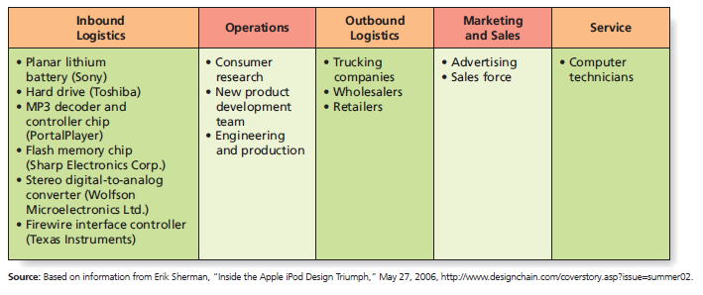
Figure 1.2 A Value Chain for the Apple iPod
Source: Based on information from Erik Sherman, “Inside the Apple iPod Design Triumph,” May 27, 2006, http://www.designchain.com/coverstory.asp?issue=summer02.
Notes:
LECTURE NOTES:
Many different players—both within and outside a firm—need to work together to create and deliver value to customers. The value chain is a useful way to appreciate all the players that work together to create value.
Value chain: A series of activities involved in designing, producing, marketing, delivering, and supporting any product. These activities include:
Inbound logistics: bringing in materials to make the product
Operations: converting the materials into the final product
Outbound logistics: shipping out the final product
Marketing: promoting and selling the final product
Service: meeting the customer’s needs by providing any additional support required

Slide 34
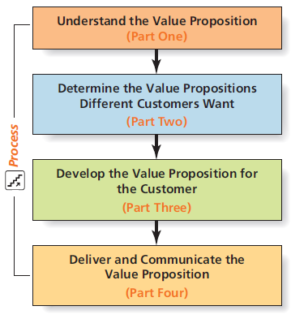
Figure 1.3 Steps in the Value Chain
Notes:
LECTURE NOTES:
Steps in the value chain that outline the process of creating and delivering value.
This is how your book is organized.

Slide 35
Consumer Generated Value: From Audience to Community
Everyday people are generating value instead of just buying it. /www.crashthesuperbowl.com
Web 4.0 puts the internet on smart phones.
Social networking platforms provide numerous opportunities for marketers.
Notes:
LECTURE NOTES:
Consumer-generated value: Occurs when everyday people generate value instead of buying it. Often, they do so by performing marketing roles such as:
Creating ads for marketer sponsored contests (www.crashthesuperbowl.com) or on their own, and posting them YouTube.
Providing input into new product development.
Buy and sell product on eBay.
Marketers need to stop treating consumers as a passive audience, and instead think of consumers as communities. Some of these consumers are not being called Amafessionals, individuals who contribute ideas for fun and challenge to gain physic income.
The growth and usability of smart phones embodies the Web 4.0 era. For marketers, social networking sites like Facebook present a unique and affordable opportunity to reach consumers in ways never thought possible before.

Slide 36
Value from Society’s Perspective
Marketing transactions may add or subtract value from society.
Stressing socially responsible and ethical decisions is good for business.
Marketing often faces criticisms.
“Dark side” marketing and consumption issues.
Notes:
LECTURE NOTES:
Marketing transactions and company activities influence the world and add or subtract value from society. Consumers trust marketers to sell products that perform as expected, and price and distribute them fairly. Unfortunately, the failures of firms such as AIG illustrate the conflicts which arise when pressure to succeed provokes dishonest business practices.
Stressing ethical or socially responsible decisions is often good business in the long run, though some find out the hard way. BPs handling of the massive Gulf oil spill in 2010 eroded its image in the marketplace, and consumers boycotted the firm’s gas stations.
Marketing is often criticized:
Marketing corrupts society because it encourages pursuit of hedonistic pleasures. Others claim that marketers . What do you think? How would you answer this allegation? (RESPONSE: Needs exist; marketers simply recommend ways of satisfying the needs.)
Marketing and advertising are unnecessary, as they foster materialism among consumers. (RESPONSE: Products are designed to meet existing needs; marketing and advertising communicates availability and how these products meet needs.)
Marketing promises miracles and manipulates consumers. (RESPONSE: Laws are in place to punish deceptive advertising; advertisers don’t know enough about people to manipulate them. People have free choice – no one is forced to buy.)
Still, marketing does have its dark side and some actions do have detrimental effects on society. Illegal actions occur – such as bait and switch (luring consumers with the promise of a sale or inexpensive item that is out of stock, only to sell them something more expensive.)
Other detrimental practices include the marketing practices of “sin” products such as tobacco or alcohol in neighborhoods where known problems with substance abuse or smoking exists.
Consumer behaviors can also have a dark side. For instance, consumer addiction is a physiological or psychological dependency on goods or services. Although most people equate addiction with drugs, consumers can use virtually anything to relieve (at least temporarily) some problem or satisfy some need to the point that reliance on it becomes extreme. “Shopaholics” turn to shopping much the way addicted people turn to drugs or alcohol. Numerous treatment centers in China, South Korea, and Taiwan (and now a few in the U.S. also) deal with cases of Internet addiction—some hard-core gamers have become so hooked that they literally forget to eat or drink and die of dehydration.

Slide 37
Value of Marketing
Marketing activities facilitate exchanges that create, communicate, and deliver value to customers.
Sellers and society at large also derive value from these exchanges.
But marketing is sometimes misused
Are criticisms of marketing justified?
Notes:
LECTURE NOTES:
Instructor should summarize the many benefits customers, firms, various stakeholders, and society as a whole receive from marketing, including improved living standards and innovations that enrich (and even save) lives.
At same time, some individual marketers have been known to take advantage of vulnerable populations through illegal and immoral practices.
Many misperceptions of the marketing discipline as being unethical are rooted in stereotypes from the selling era, in which marketers were known for aggressive promotional practices.
DISCUSSION NOTE:
On the whole, are criticisms of marketing justified?

Slide 38
Marketing as a Process (1 of 2)
Marketers ask questions related to:
Product benefits
Capabilities
Additional customer groups
Changes in technology
Changes in social and cultural values
Environmental issues
Legal and regulatory issues
Notes:
LECTURE NOTES:
Each of these bullet points are questions that a marketer will ask when it comes to thinking of marketing as a process. These appear on page 24 of your text.

Slide 39
Marketing as a Process (2 of 2)
Marketing plan
Mass market
Market segment
Target market
Positioning
Notes:
LECTURE NOTES:
A marketing plan is a document that explains the marketing strategy.
Mass market includes all possible customers.
A market segment is a distinct group of customers within a larger market who are similar to one another in some way.
Target market is where marketers focus their marketing plan and direct their marketing efforts.
Positioning uses marketing communication to place their brand in the minds of their customers in relation to the competition.

Slide 40
Copyright

